Slide 1

Costing 101
An introduction to costing and pricing of products and services

Slide 2

Definition of costing
The process of calculating/determining/measuring what a unit of product or service should be valued when produced/provided.
Unit: quantity of good or service provided to customer – kg, package, grams, hour, minute etc
Product: tangible item offered for sale that can be produced/purchased and stored
Service: intangible item offered for sale at time of need/demand that cannot be stored in advance

Slide 3

Illustration/Exercise 1

Slide 4














Illustration/Exercise 1

Slide 5
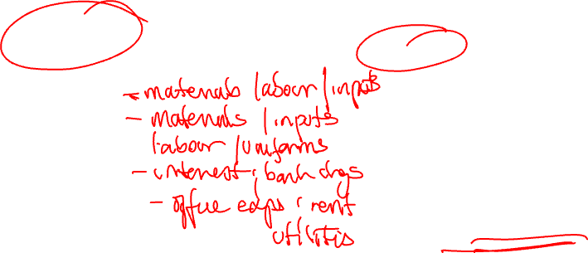
Categorisation of costs
FUNCTION
TYPE
Production
Purchasing
Labour/People
Finance
Administration
Direct: costs that can be traced to each unit of your product or service; must be incurred to deliver product/service
Indirect/overheads: costs that are incurred to ensure operation of business but not essential for creation of product/service

Slide 6
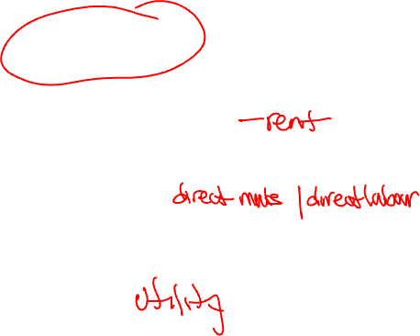
Categorisation of costs
BEHAVIOUR
Other
Fixed: cost incurred that are not affected by activity in the short term
Variable: costs incurred that change as activity changes
Mixed: costs that possess a component of fixed and variable elements
Overheads: costs incurred outside of production fo smooth function of business activity
Non-production: any costs that are not production related or driven

Slide 7

Illustration/Exercise 2

Slide 8
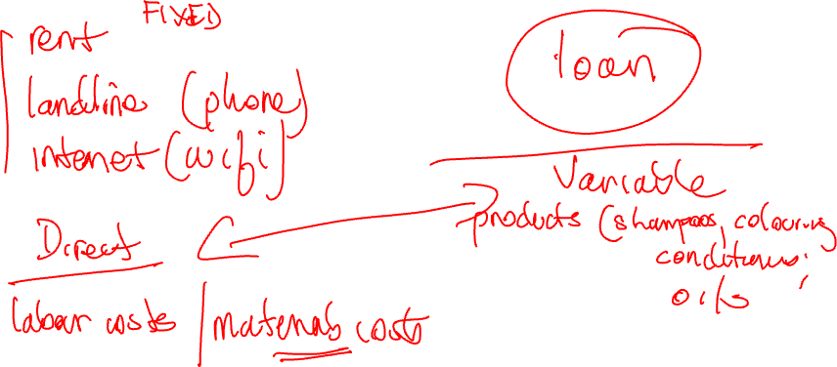
Illustration/Exercise 2

Slide 9

Preparing your cost analysis
List
List your direct costs of production (unit or total) – these should all be variable
List
List your indirect costs of production
Calculate
Calculate total production costs (unit or total)
List
List your overhead costs – these may be fixed or variable or mixed
Determine
Determine how much of your overhead costs should be added to your production costs
Add
Add your markup to determine selling price

Slide 10
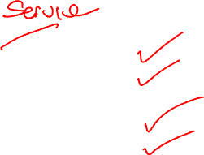
Cost Card – part 1
Production costs
Direct materials
Direct labour
Indirect materials
Indirect labour

Slide 11


Cost Card – part 2
Overhead costs
Variable overheads
Fixed overheads
Mixed

Slide 12

Illustration/Exercise 3

Slide 13
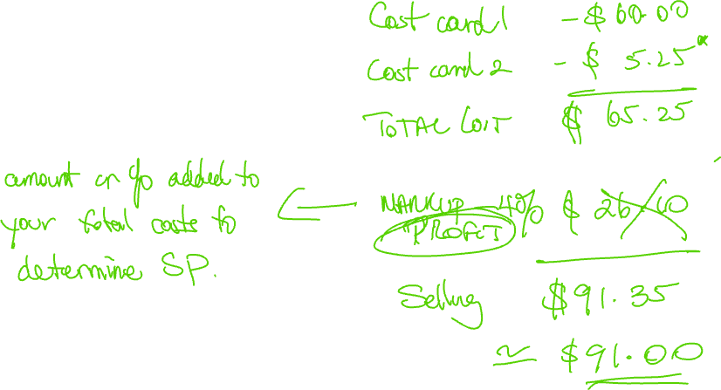
Illustration/Exercise 3

Slide 14

Understanding your Price Structure
Cost – from your cost card
Profit – consider indutry norms/trends
Selling price – determine your real selling price, then consider your pricing strategy.

Slide 15
Pricing strategy
Cost plus pricing
Competitive pricing
Price skimming
Penetration pricing
Value based pricing
Economy pricing
Dynamic pricing

Slide 16
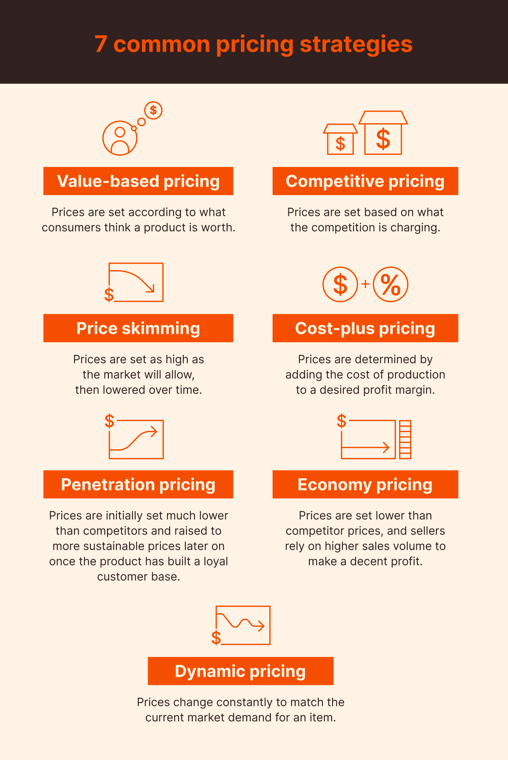


Slide 17

Question & Answers/Discussion

